Slide 1
Data Driven Artificial intelligent systems
Topic: Backward chaining

Slide 2
Backward chaining
Inference engine:
The inference engine is the component of the intelligent system in artificial intelligence, which applies logical rules to the knowledge base to infer new information from known facts. The first inference engine was part of the expert system. Inference engine commonly proceeds in two modes, which are:
Forward chaining
Backward chaining

Slide 3

Backward chaining
American(x) ∧ Weapon(y) ∧ Sells(x,y,z) ∧ Hostile(z) ⇒ Criminal(x)
Owns(Nono,M₁) ∧ Missile(M₁)
Missile(x) ∧ Owns(Nono,x) ⇒ Sells(West,x,Nono)
Missile(x) ⇒ Weapon(x) Enemy(x,America) ⇒ Hostile(x)
American(West) Enemy(Nono,America)

Slide 4
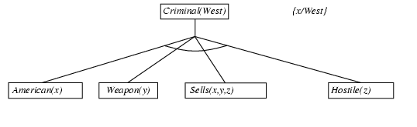
Backward chaining Proof
American(x) ∧ Weapon(y) ∧ Sells(x,y,z) ∧ Hostile(z) ⇒ Criminal(x)
Owns(Nono,M₁) ∧ Missile(M₁)
Missile(x) ∧ Owns(Nono,x) ⇒ Sells(West,x,Nono)
Missile(x) ⇒ Weapon(x) Enemy(x,America) ⇒ Hostile(x)
American(West) Enemy(Nono,America)

Slide 5
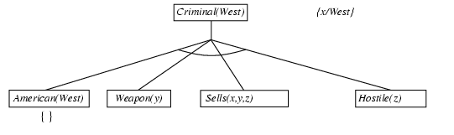
Backward chaining Proof
American(x) ∧ Weapon(y) ∧ Sells(x,y,z) ∧ Hostile(z) ⇒ Criminal(x)
Owns(Nono,M₁) ∧ Missile(M₁)
Missile(x) ∧ Owns(Nono,x) ⇒ Sells(West,x,Nono)
Missile(x) ⇒ Weapon(x) Enemy(x,America) ⇒ Hostile(x)
American(West) Enemy(Nono,America)

Slide 6
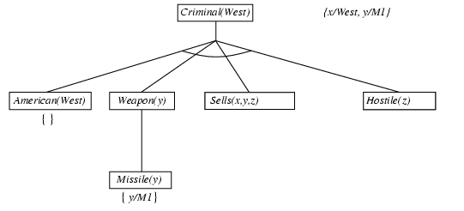
Backward chaining Proof
American(x) ∧ Weapon(y) ∧ Sells(x,y,z) ∧ Hostile(z) ⇒ Criminal(x)
Owns(Nono,M₁) ∧ Missile(M₁)
Missile(x) ∧ Owns(Nono,x) ⇒ Sells(West,x,Nono)
Missile(x) ⇒ Weapon(x) Enemy(x,America) ⇒ Hostile(x)
American(West) Enemy(Nono,America)

Slide 7
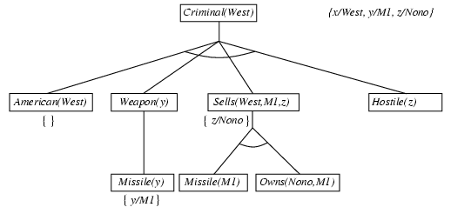
Backward chaining Proof
American(x) ∧ Weapon(y) ∧ Sells(x,y,z) ∧ Hostile(z) ⇒ Criminal(x)
Owns(Nono,M₁) ∧ Missile(M₁)
Missile(x) ∧ Owns(Nono,x) ⇒ Sells(West,x,Nono)
Missile(x) ⇒ Weapon(x) Enemy(x,America) ⇒ Hostile(x)
American(West) Enemy(Nono,America)

Slide 8
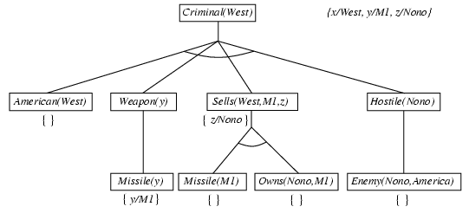
Backward chaining example
American(x) ∧ Weapon(y) ∧ Sells(x,y,z) ∧ Hostile(z) ⇒ Criminal(x)
Owns(Nono,M₁) ∧ Missile(M₁)
Missile(x) ∧ Owns(Nono,x) ⇒ Sells(West,x,Nono)
Missile(x) ⇒ Weapon(x) Enemy(x,America) ⇒ Hostile(x)
American(West) Enemy(Nono,America)

Slide 9
Forward vs. backward chaining
FC is data-driven, automatic, unconscious processing,
e.g., object recognition, routine decisions
BC is goal-driven, appropriate for problem-solving,
e.g., Where are my keys? How do I get into a PhD program?
Complexity of BC can be much less than linear in size of KB
End of Session

Slide 10
summary
In this session the concept of forward chaining and backward chaining are discussed in details and shown how forward chaining and backward chaining are used to prove the first order logic statements.

Slide 11

SELF ASSESSMENT QUESTIONS
Which algorithm will work backward from the goal to solve a problem?
Forward chaining
Backward chaining
Hill-climb algorithm
None of the mentioned
What is the condition of variables in first-order literals?
Existentially quantified
Universally quantified
Both Existentially & Universally quantified
None of the mentioned

Slide 12
TERMINAL QUESTIONS
Define backward chaining and explain how it differs from forward chaining.
What are the advantages and disadvantages of using backward chaining in problem-solving?
Describe at least three real-world applications where backward chaining is commonly used. Provide examples for each application.
Discuss the importance of the knowledge base in backward chaining systems. How does the quality of the knowledge base impact the effectiveness of the system?
Differentiate between Forward chaining and Backward chaining?

Slide 13
References
Reference Books:
1. Russel and Norvig, ‘Artificial Intelligence’, third edition, Pearson Education, PHI, (2015)
2. Elaine Rich & Kevin Knight, ‘Artificial Intelligence’, 3nd Edition, Tata Mc Graw Hill Edition, Reprint( 2008)
Sites and Web links:
https://www.virtusa.com/digital-themes/heuristic-search-techniques
https://towardsdatascience.com/a-star-a-search-algorithm-eb495fb156bb

